Slide 1

Energetic Electron Flux Predictions in the Near-Earth Plasma Sheet from Solar Driving
Brian Swigerª, Mike Liemohnª, Natalia Ganushkina^{a,b}
a. University of Michigan; b. Finnish Meteorological Institute
Machine Learning in Heliophysics
21-25 March, 2022
Boulder, CO

Slide 2
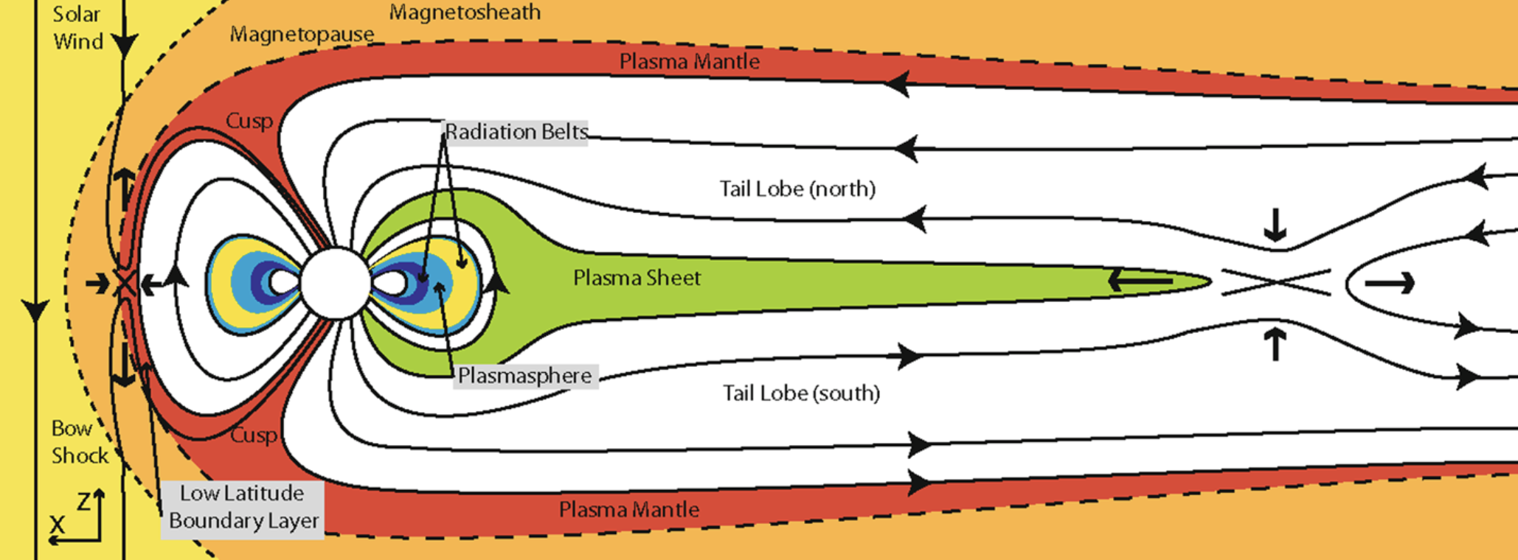
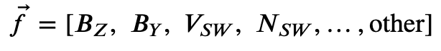
background & motivation
Solar wind influences plasma sheet
Local (global) enhancements in plasma sheet produce local (global) enhancements in electron radiation belt, ring current, spacecraft charging environment
Flux of 1-100keV electrons varies quickly
Can local eflux enhancements be modeled (predicted / forecast) accurately?
To what extent do individual solar driving parameters influence the global behavior?
Eastwood et al., 2014

Slide 3
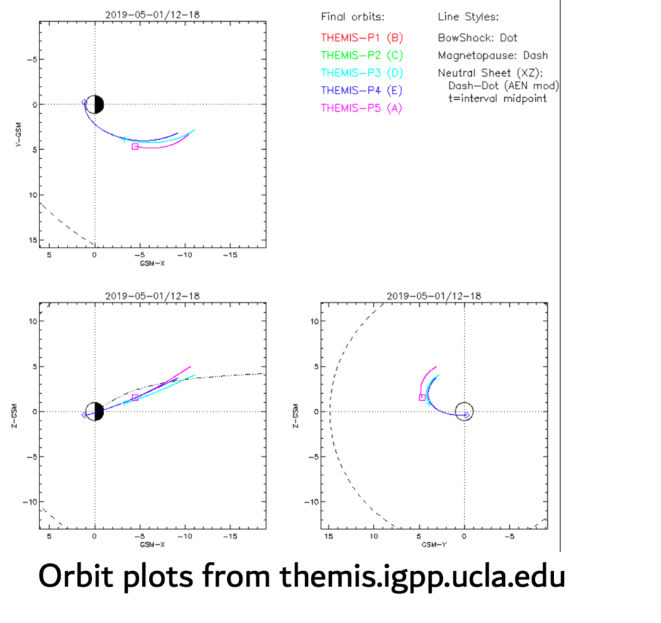
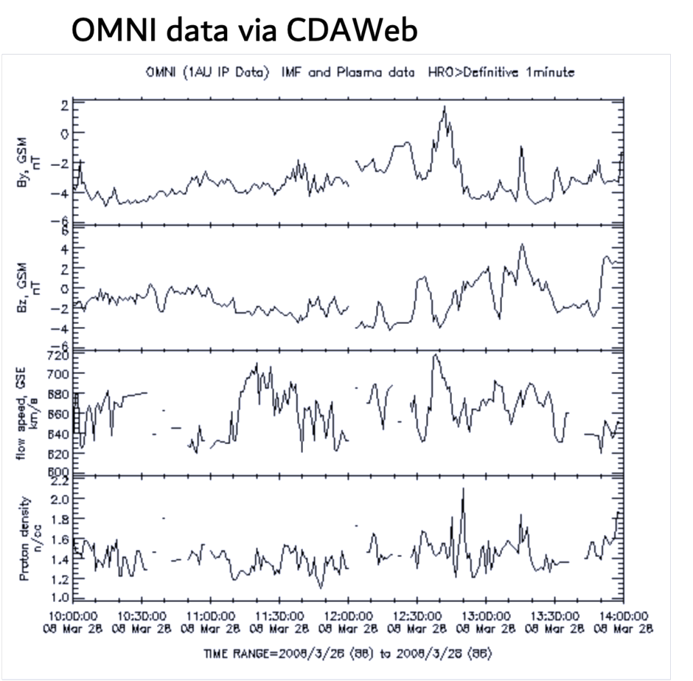
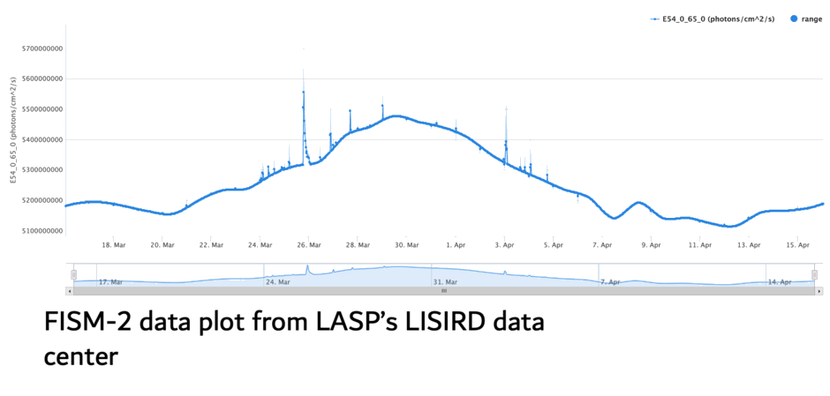
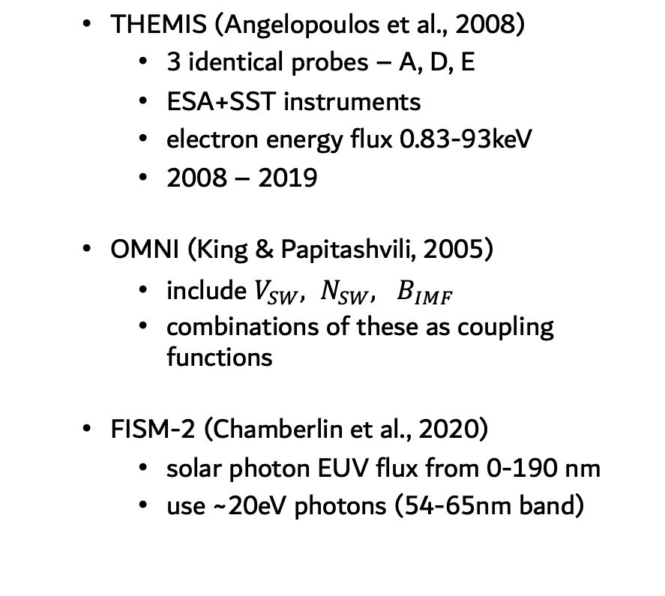
data sources
THEMIS (Angelopoulos et al., 2008)
3 identical probes – A, D, E
ESA+SST instruments
electron energy flux 0.83-93keV
2008 – 2019
OMNI (King & Papitashvili, 2005)
include $V_{SW}, N_{SW}, B_{IMF}$
combinations of these as coupling functions
FISM-2 (Chamberlin et al., 2020)
solar photon EUV flux from 0-190 nm
use ~20eV photons (54-65nm band)

Slide 4
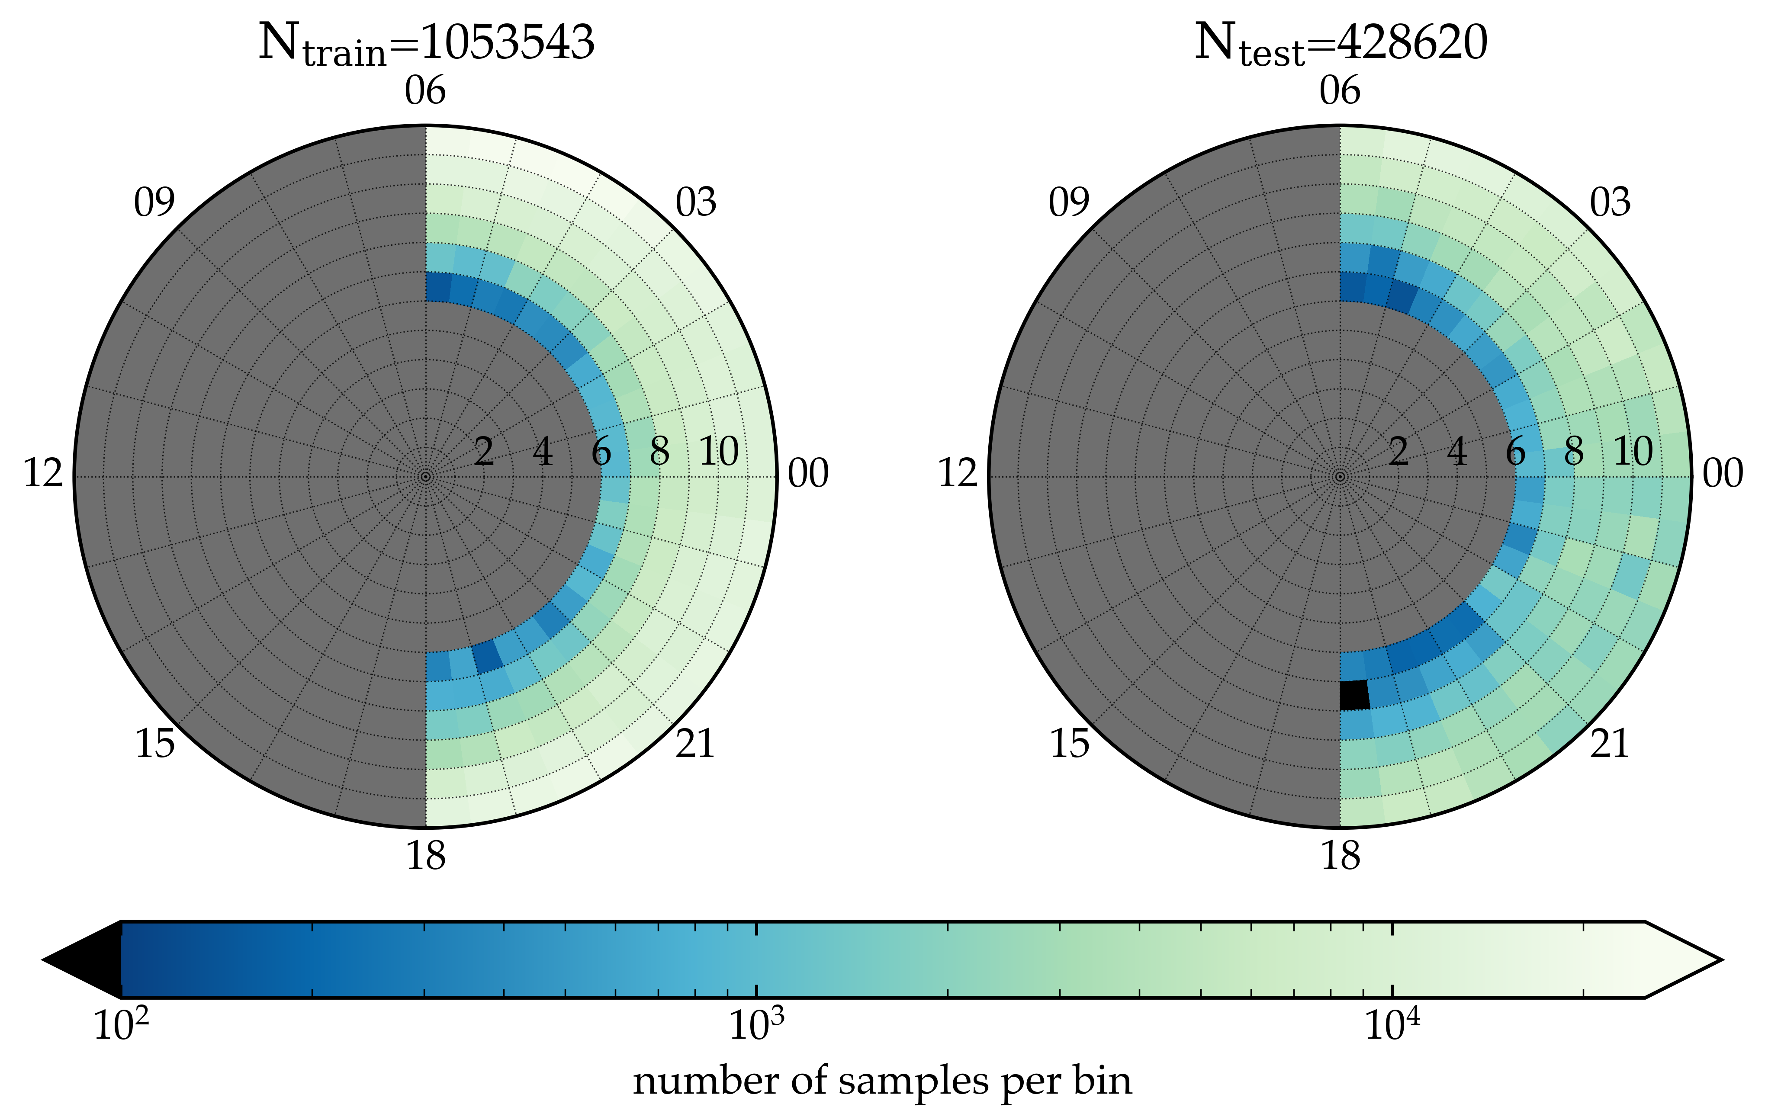
sampling the plasma sheet
restrict THEMIS observations to:
6-12 Re; 18-06 MLT; Plasma beta > 1
down-sample to 1-min mean flux
remove bad data (e.g. ESA saturation)
train/test split by year: test 2010, 2013, 2016, 2019; all others train
binning only shows sampling distribution; not used for training

Slide 5
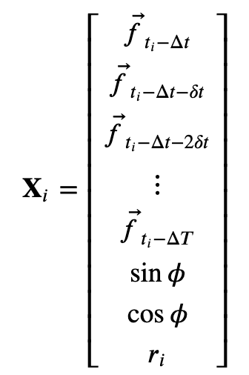
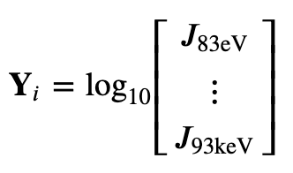
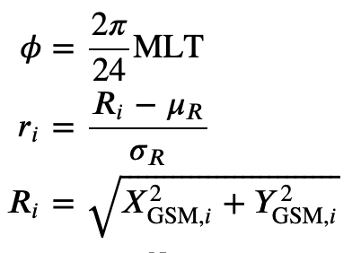
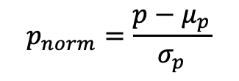
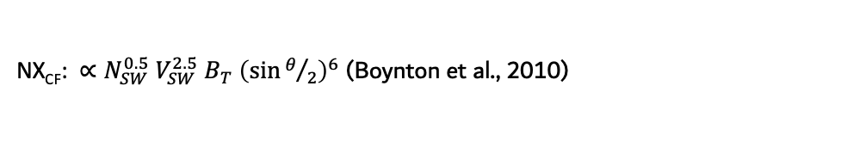
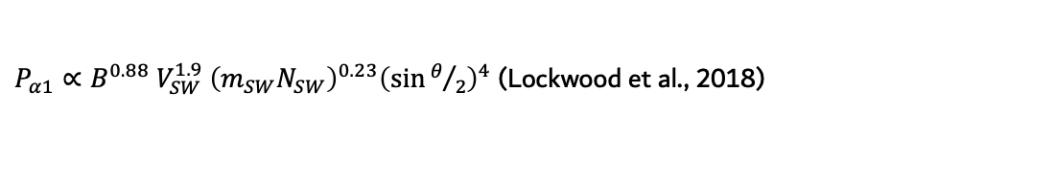
preprocess data
target vectors from THEMIS data
w₁₁
a₁
feature vectors:
OMNI,
SW-mag coupling fns,
FISM-2,
location data
x₁
w₁₂
y₁
a₂
x₂
y₂
:
:
:
:
x₄₂₆
y₃₁
$$p_{norm}=\frac{p−μ_{p}}{σ_{p}}$$
a_{n}
each target vector has
associated timestamp, location data
$P_{α1}∝B^{0.88} V_{SW}^{1.9} {\left(m_{SW}N_{SW}\right)}^{0.23}{\left(\sin{θ/2}\right)}^{4}$ (Lockwood et al., 2018)
NX_{CF}: $∝N_{SW}^{0.5} V_{SW}^{2.5} B_{T}{ \left(\sin{θ/2}\right)}^{6}$ (Boynton et al., 2010)
B_{Z, pow} : ULF wave (Pc5) power index of the IMF B_{Z} (e.g., Wang et al., 2017)

Slide 6

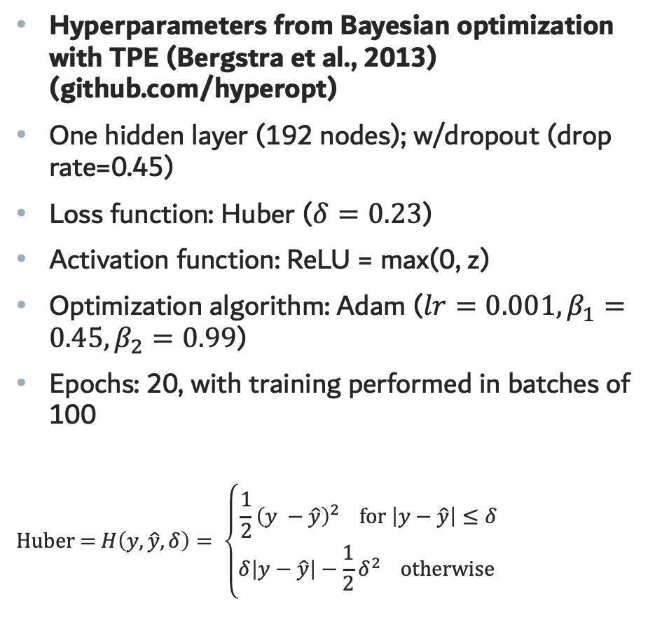
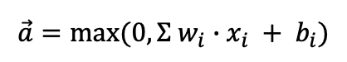

neural network training
Hyperparameters from Bayesian optimization with TPE (Bergstra et al., 2013) (github.com/hyperopt)
One hidden layer (192 nodes); w/dropout (drop rate=0.45)
Loss function: Huber ($δ=0.23$)
Activation function: ReLU = max(0, z)
Optimization algorithm: Adam ($lr=0.001, β_{1}=0.45, β_{2}=0.99$)
Epochs: 20, with training performed in batches of 100
$$\text{Huber}\text{ = }H\left(y, \hat{y}, δ\right)= \left\{\begin{aligned}\frac{1}{2}{\left(y −\hat{y}\right)}^{2} \text{for} \left|y−\hat{y}\right|≤δ \\ δ\left|y−\hat{y}\right|−\frac{1}{2}δ^{2} \text{otherwise} \end{aligned}\right.$$
w₁₁
a₁
x₁
w₁₂
y₁
a₂
x₂
y₂
:
:
:
:
x_{m}
y_{p}
w_{mn}
a_{n}
Input Layer
Hidden Layer
Output Layer
$$\vec{x}$$
$$\vec{a}=max(0,Σ w_{i}∙x_{i} + b_{i})$$
$$\hat{\vec{y}}$$
Number of connections stochastically reduced by dropout (drop rate ~45%); to help prevent over-fitting

Slide 7
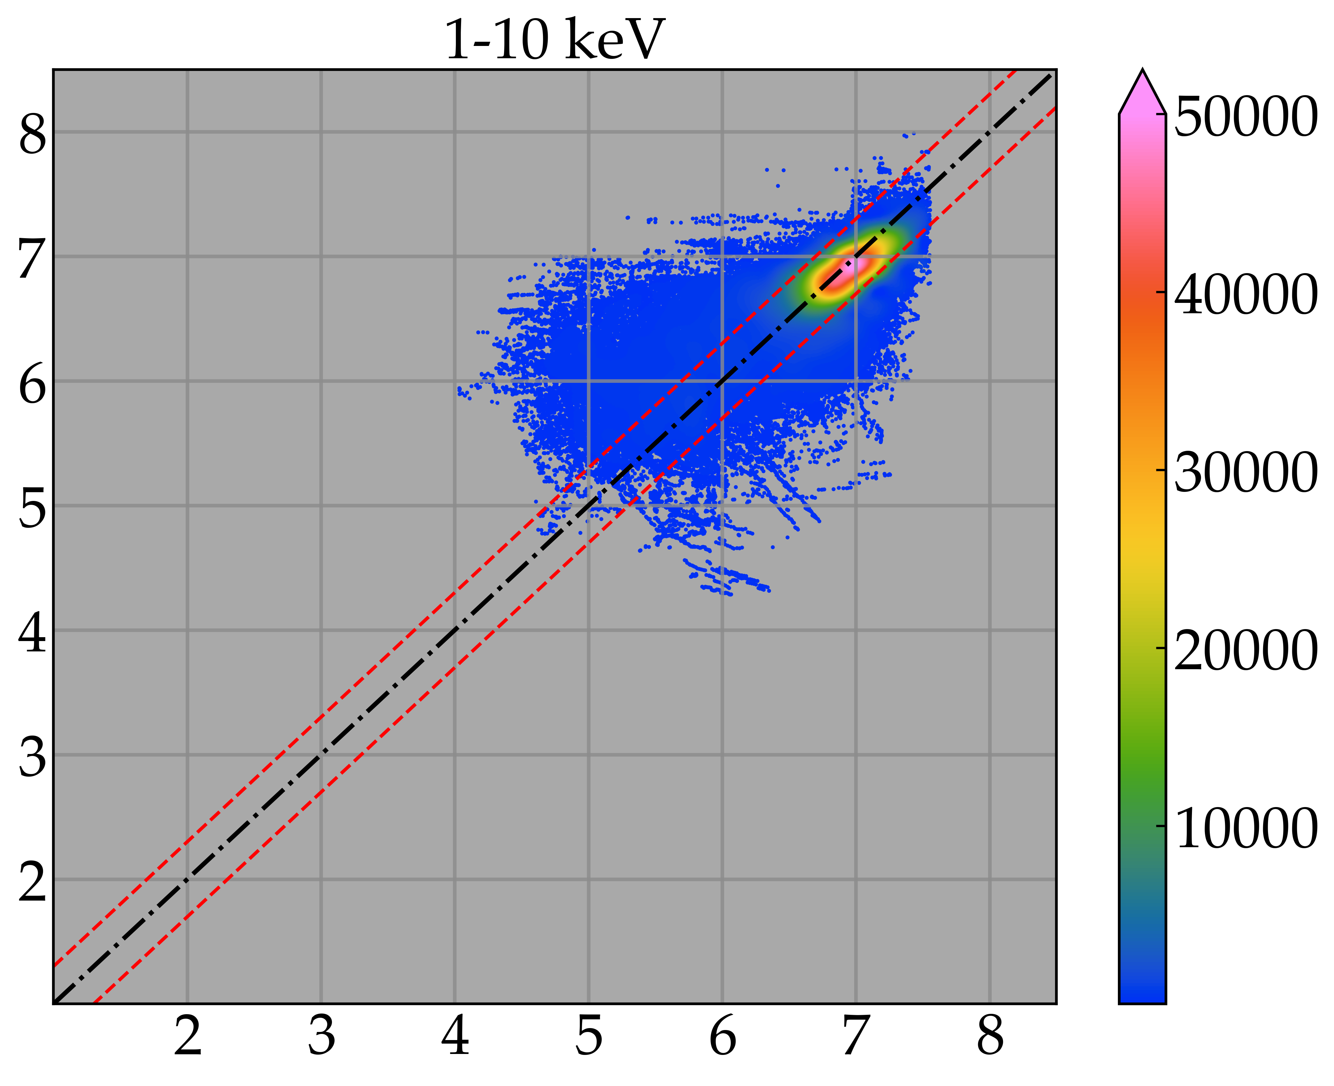
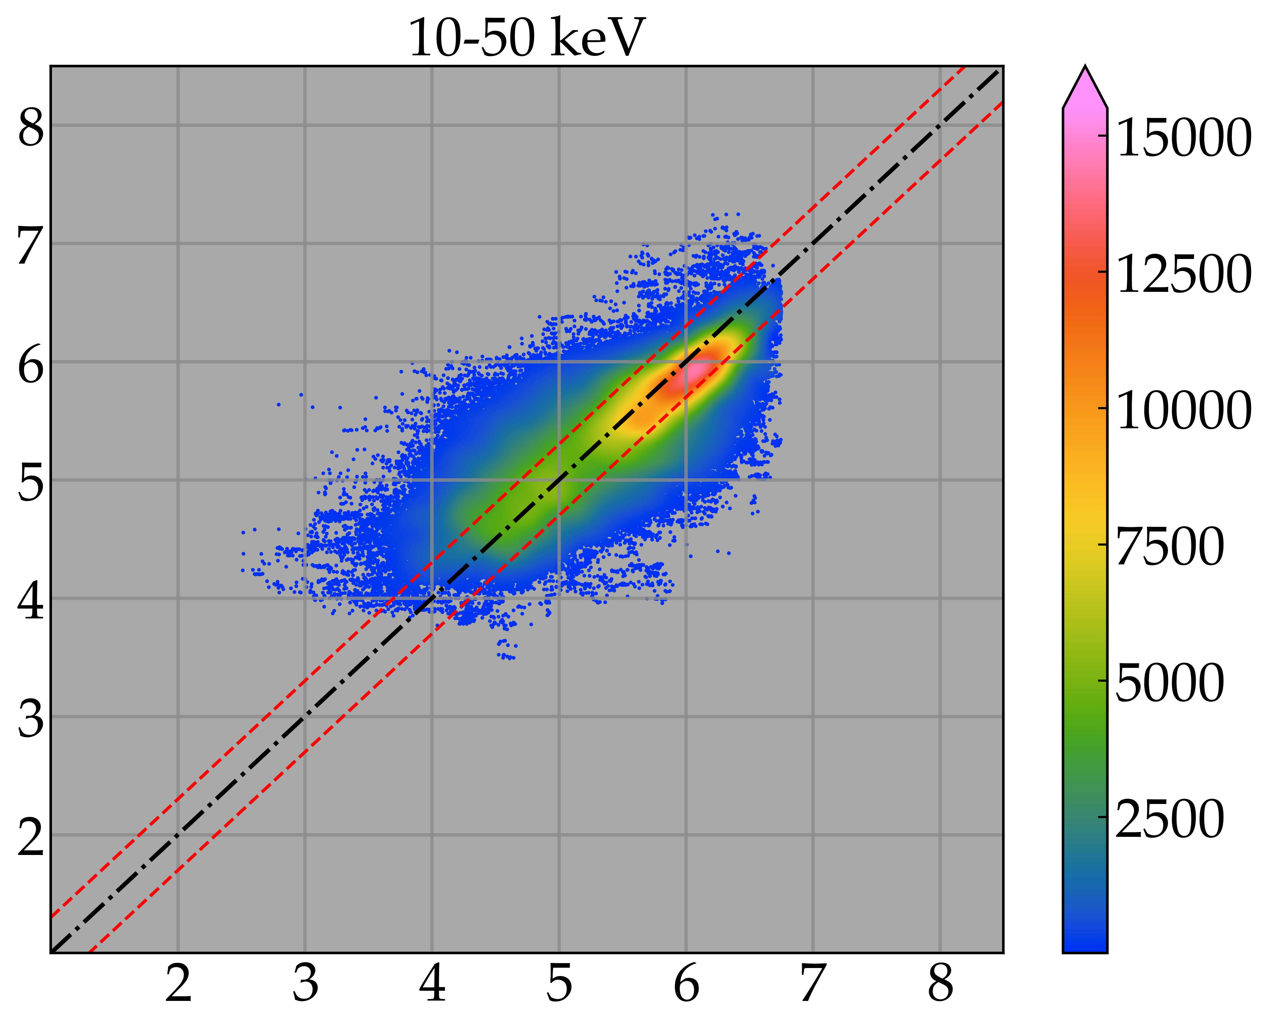
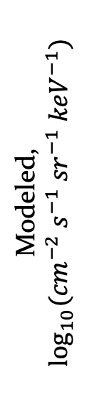
model results – long timescale
Overall Model Scores:
Modeled, $\log_{10}{({cm}^{−2} s^{−1} {sr}^{−1} {keV}^{−1})}$
Metric | Value
PE | 0.91
MSA | 71%
Pearson R | 0.95
SSPB | -2.0%
ME | 0.03 log₁₀(flux)
MAE | 0.33 log₁₀(flux)
MSE | 0.22 log₁₀(flux)
sMAPE | 6.9%
Within factor of 2 | 60%
Observed, $\log_{10}{({cm}^{−2} s^{−1} {sr}^{−1} {keV}^{−1})}$
Model Scores 1-10keV:
Model Scores 10-50keV:
Metric | Value
PE | 0.60
MSA | 32%
SSPB | -10%
W/in fact 2 | 84%
Metric | Value
PE | 0.65
MSA | 73%
SSPB | -13%
W/in fact 2 | 60%

Slide 8
model results short timescale
Model Scores April 2010 →
Metric | Value
PE | 0.87
MSA | 95%
Pearson R | 0.94
SSPB | -33%
W/in fact 2 | 52%
Model Scores 8hr period →
Metric | Value
PE | 0.88
MSA | 77%
Pearson R | 0.97
SSPB | -44%
W/in fact 2 | 58%

Slide 9
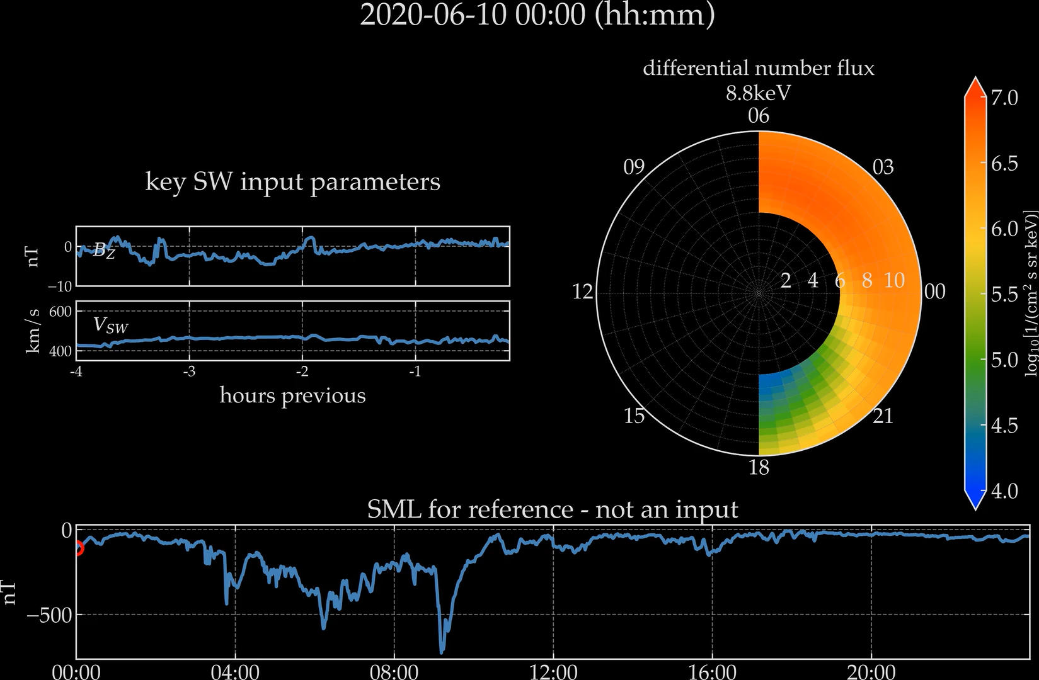

Slide 10
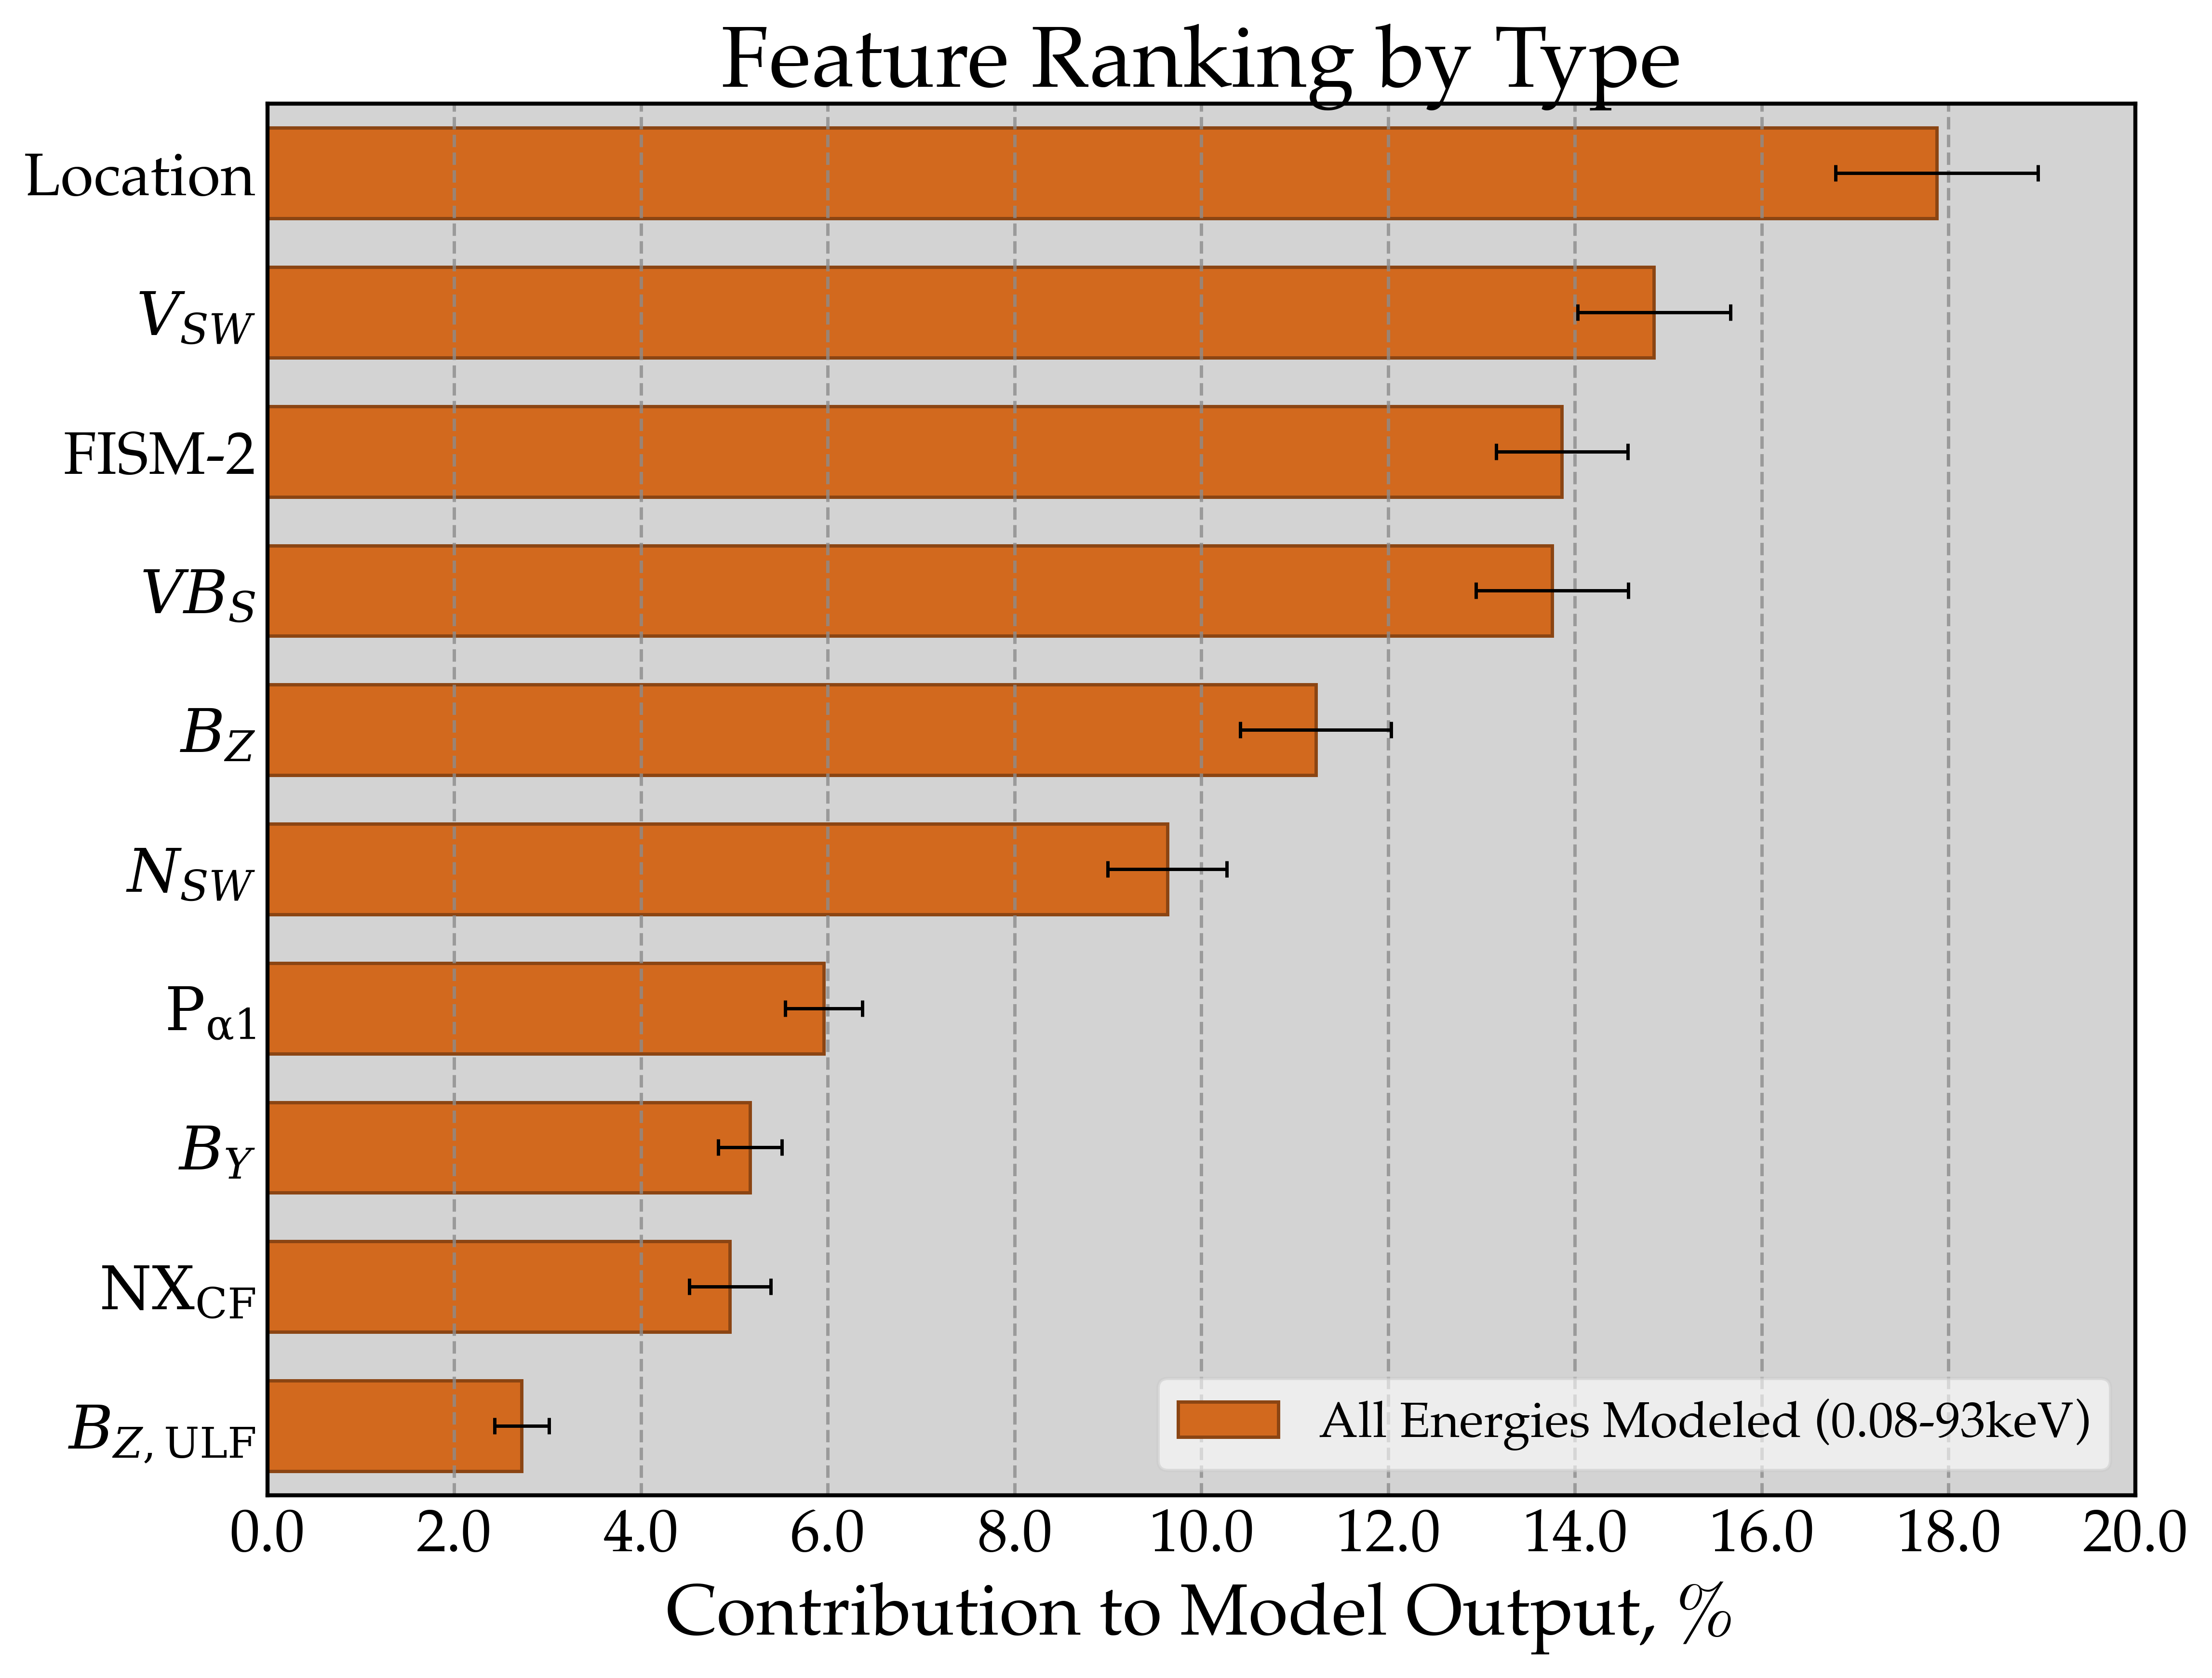
feature ranking and correlations
-features ranked using DeepSHAP (Lundberg & Lee, 2017)
-DeepSHAP: DeepLIFT (Shrikumar et al., 2017) + SHAP
-propagate Shapley sampling values to entire NN
despite using high resolution, it doesn’t help resolve short timescale predictions
the most important features have high autocorrelation

Slide 11
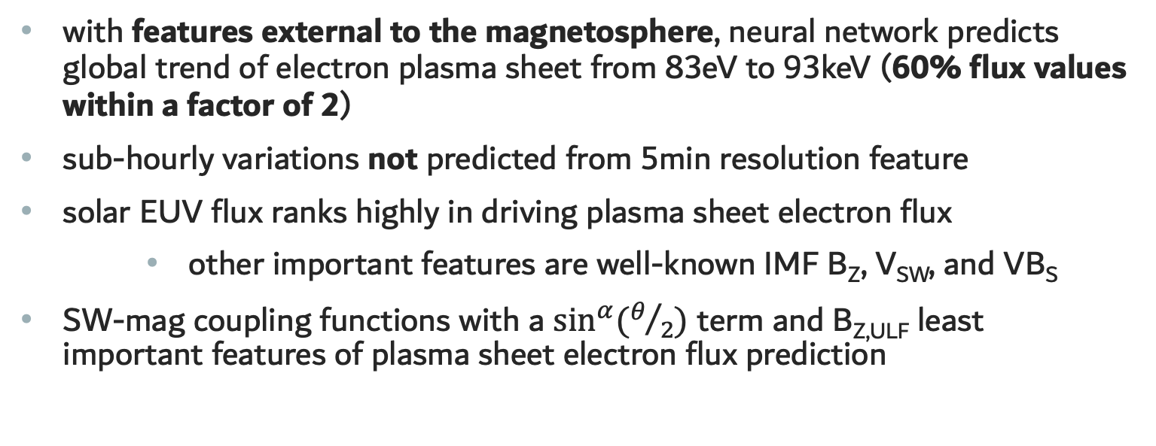
summary and conclusions
with features external to the magnetosphere, neural network predicts global trend of electron plasma sheet from 83eV to 93keV (60% flux values within a factor of 2)
sub-hourly variations not predicted from 5min resolution feature
solar EUV flux ranks highly in driving plasma sheet electron flux
other important features are well-known IMF B_{Z}, V_{SW}, and VB_{S}
SW-mag coupling functions with a $\sin^{α}{(θ/2)}$ term and B_{Z,ULF} least important features of plasma sheet electron flux prediction
potential use as a boundary condition for inner magnetosphere models; adaption to operations if using real-time inputs

